Slide 1



School of Computing and Information Technology, Eastern International University (EIU) - Vietnam

Slide 2

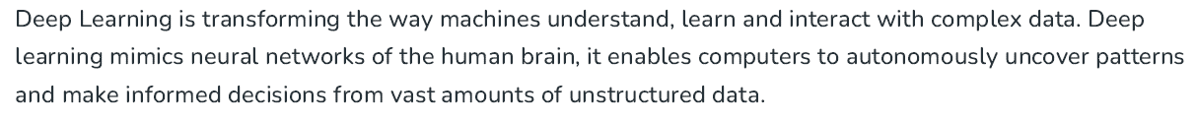
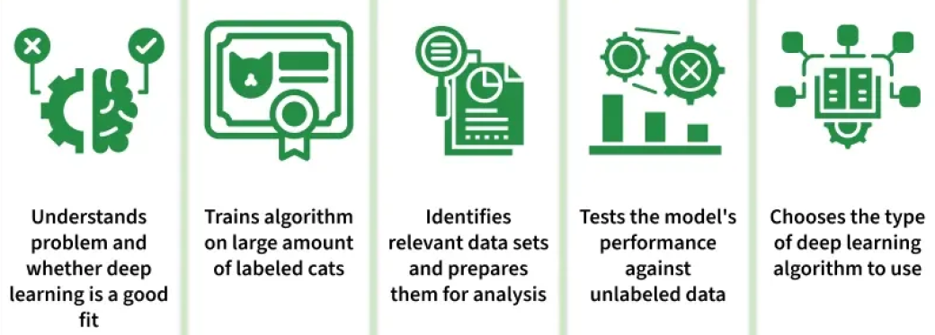
School of Computing and Information Technology, Eastern International University (EIU) - Vietnam

Slide 3


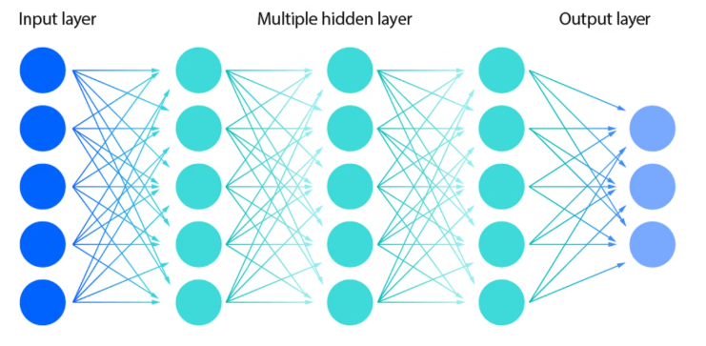
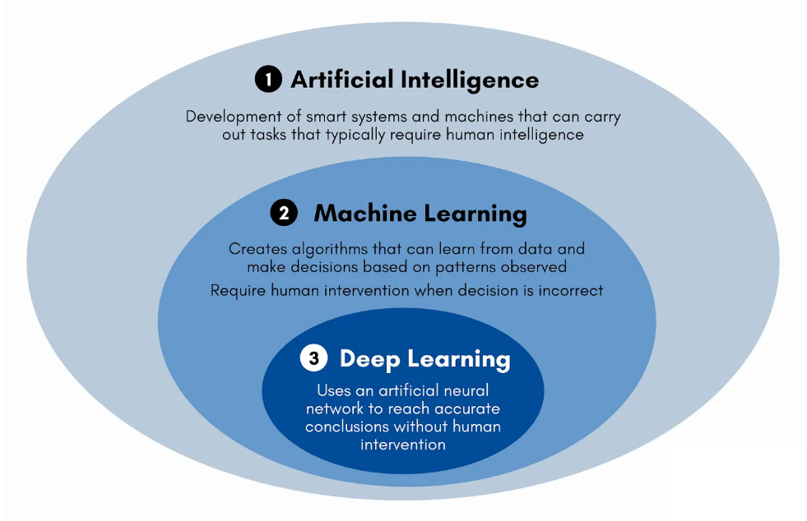


Slide 4
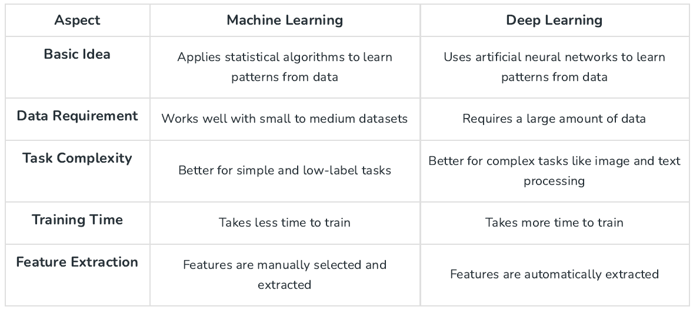

Slide 5
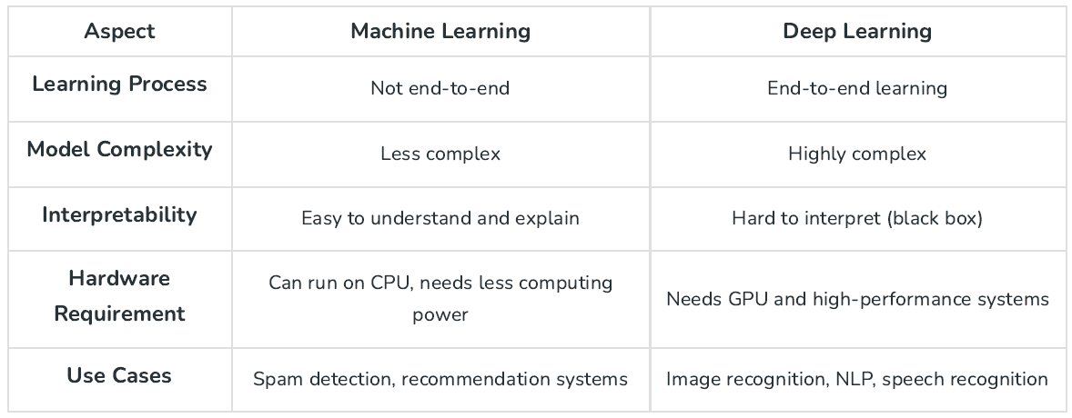
School of Computing and Information Technology, Eastern International University (EIU) - Vietnam

Slide 6

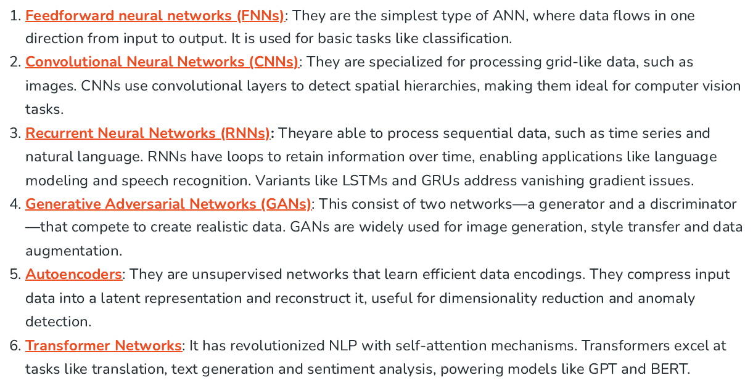

Slide 7
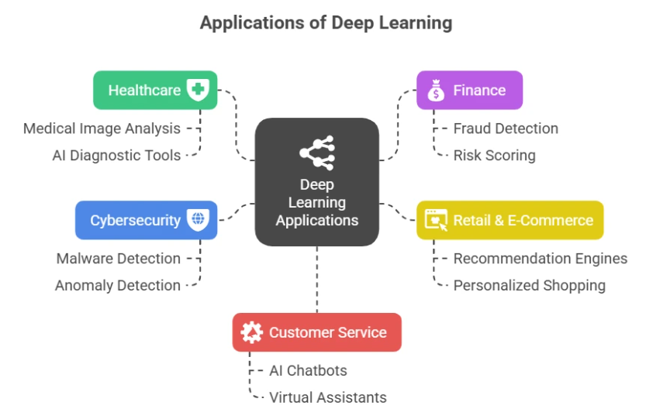
School of Computing and Information Technology, Eastern International University (EIU) - Vietnam

Slide 8

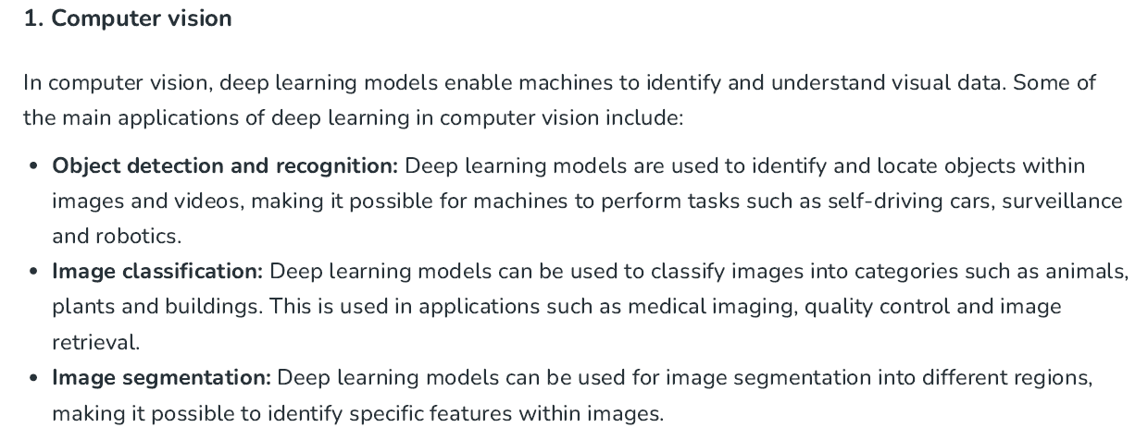
School of Computing and Information Technology, Eastern International University (EIU) - Vietnam

Slide 9
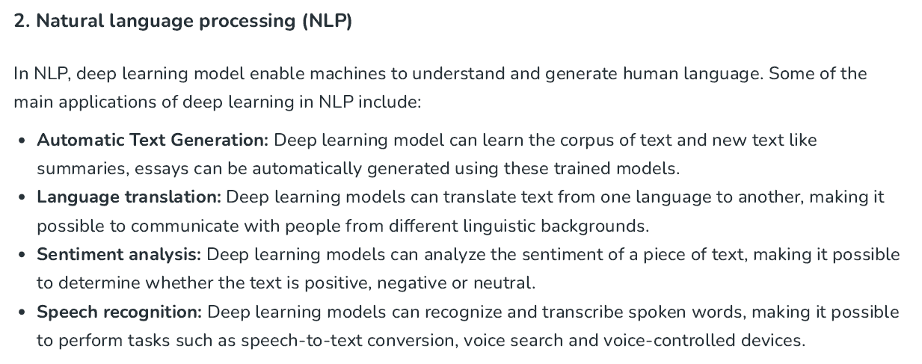
School of Computing and Information Technology, Eastern International University (EIU) - Vietnam

Slide 10
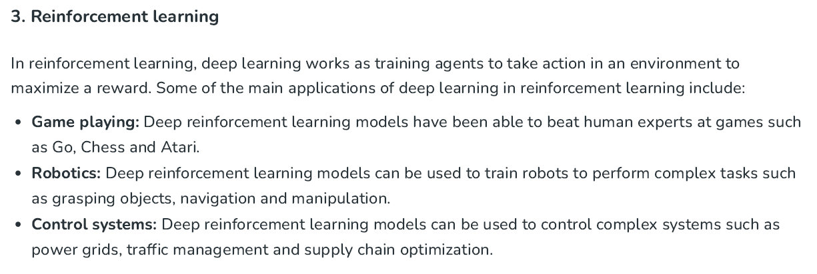
School of Computing and Information Technology, Eastern International University (EIU) - Vietnam

Slide 11
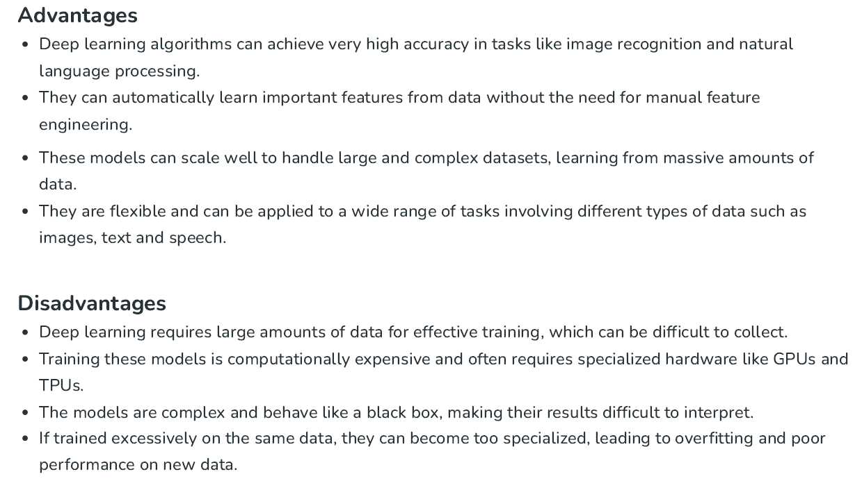

Slide 12
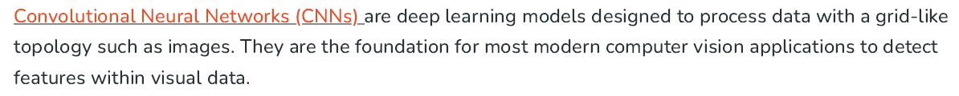
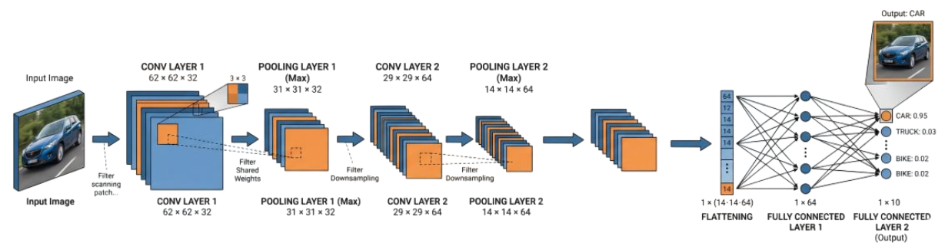
School of Computing and Information Technology, Eastern International University (EIU) - Vietnam

Slide 13

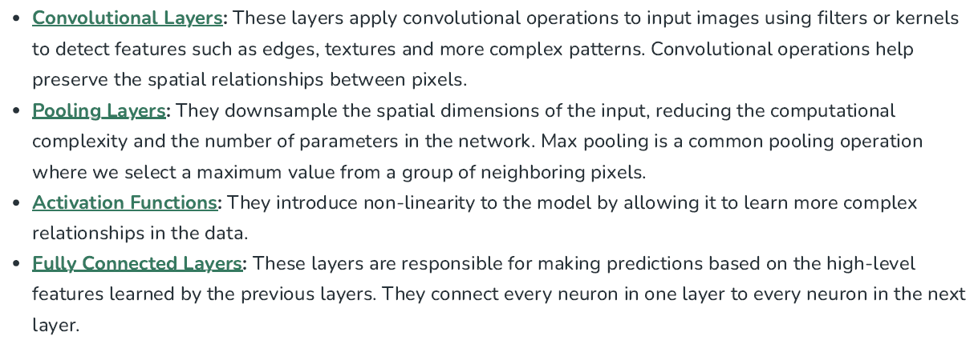
School of Computing and Information Technology, Eastern International University (EIU) - Vietnam

Slide 14
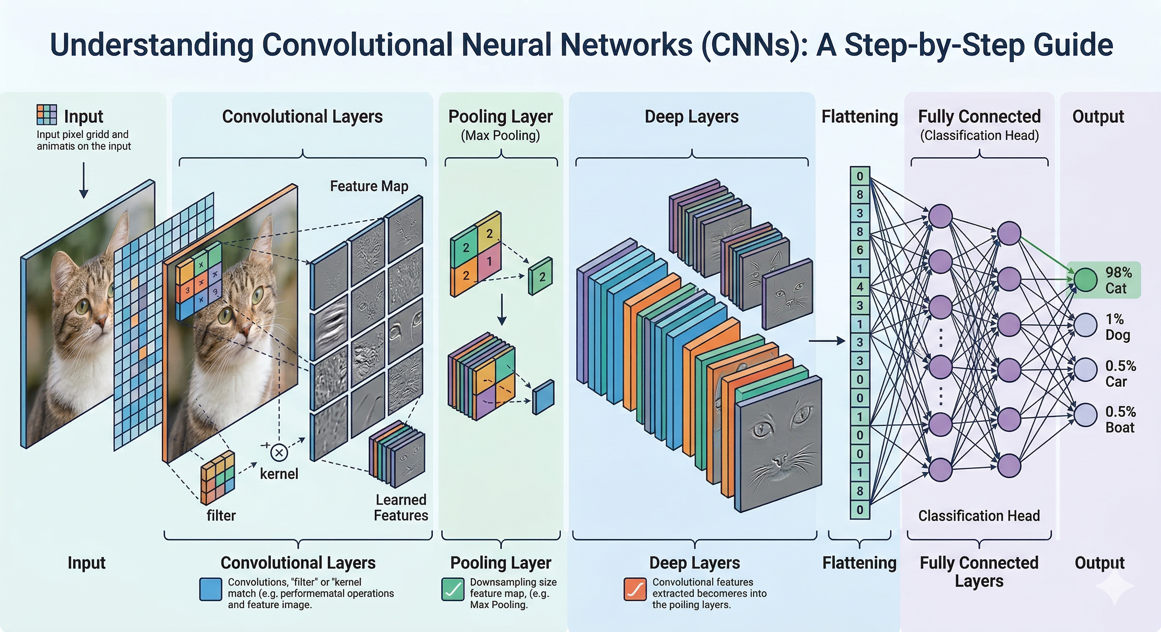

Slide 15

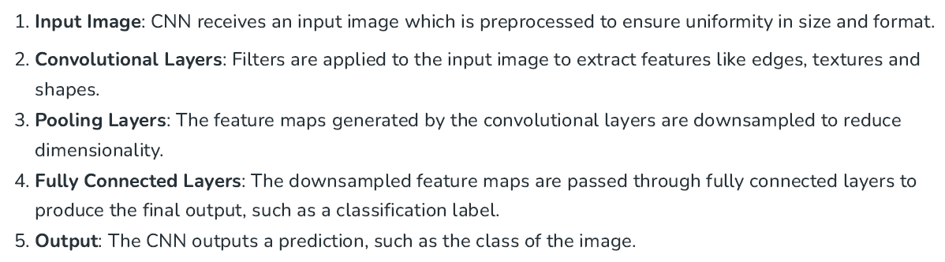
School of Computing and Information Technology, Eastern International University (EIU) - Vietnam

Slide 16
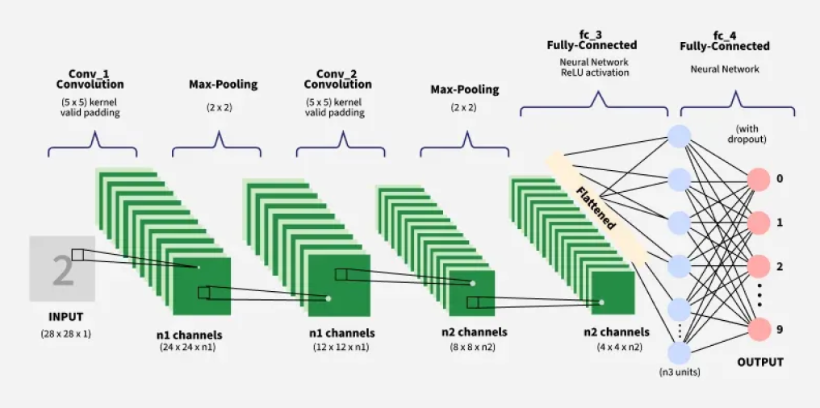

Slide 17
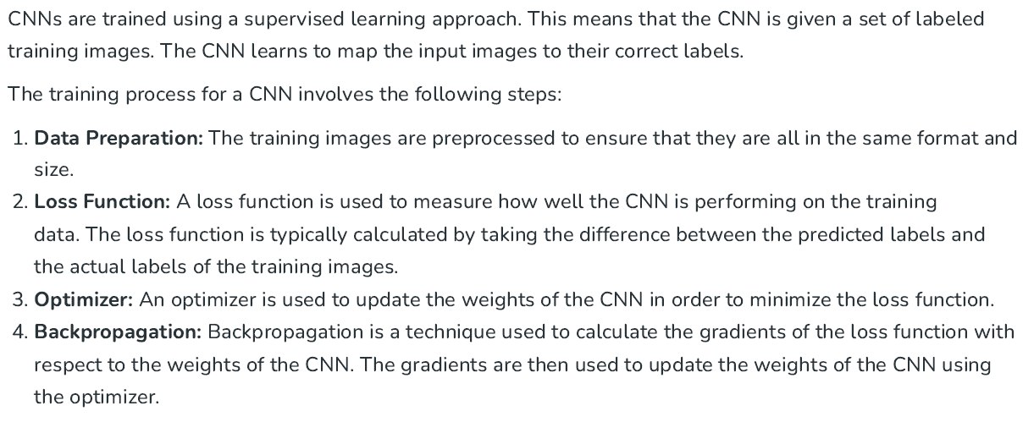
School of Computing and Information Technology, Eastern International University (EIU) - Vietnam

Slide 18
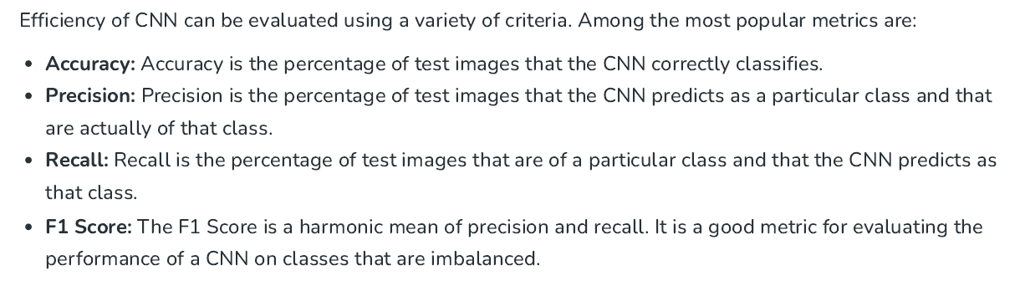
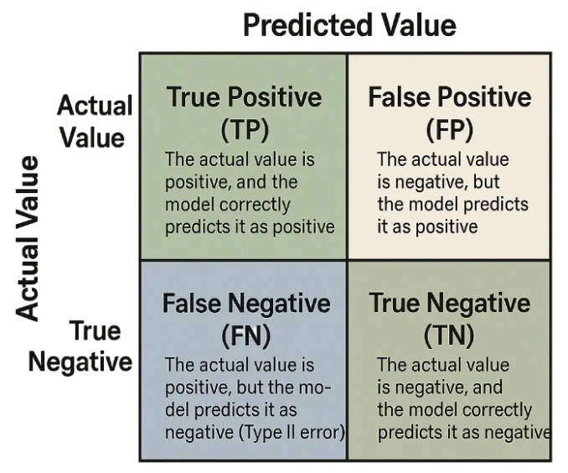





Slide 19
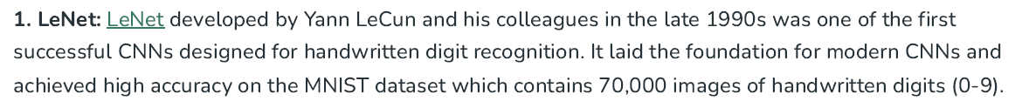
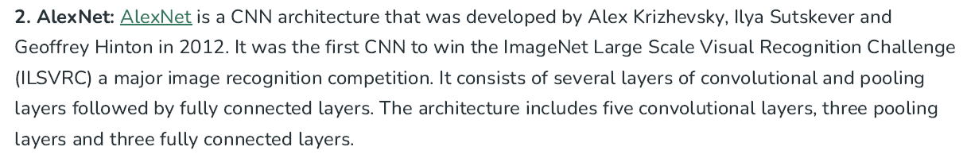
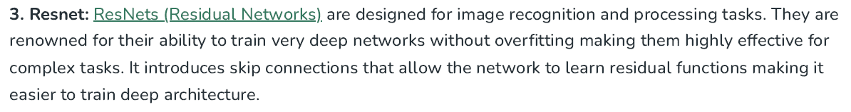
School of Computing and Information Technology, Eastern International University (EIU) - Vietnam

Slide 20
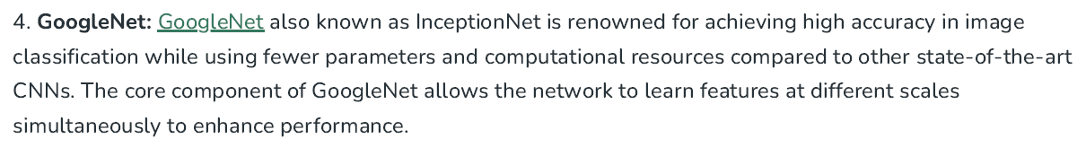
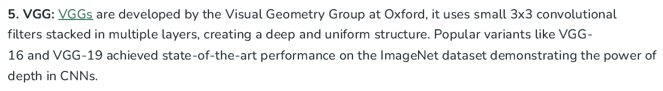
School of Computing and Information Technology, Eastern International University (EIU) - Vietnam

Slide 21
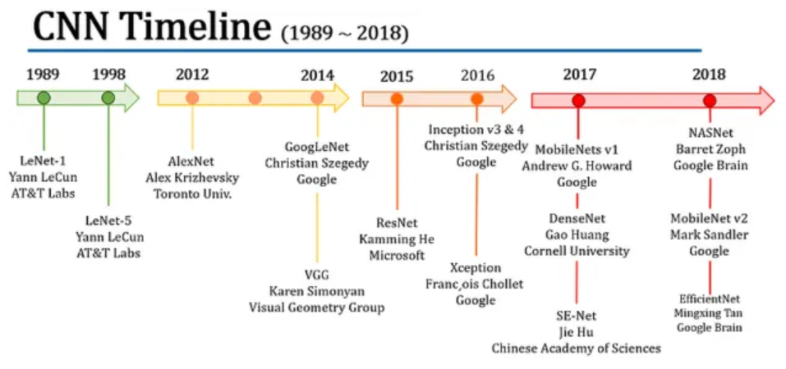
School of Computing and Information Technology, Eastern International University (EIU) - Vietnam

Slide 22

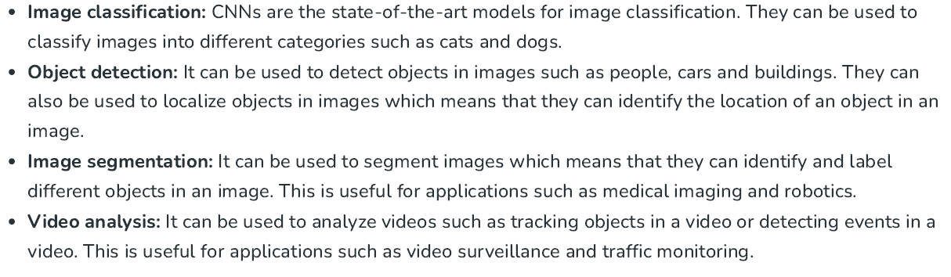
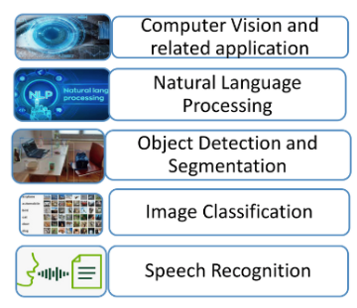
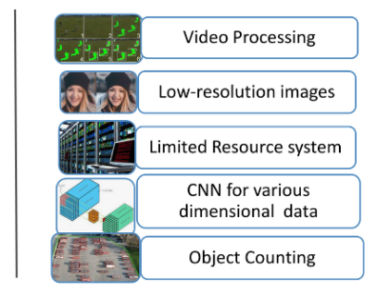

Slide 23
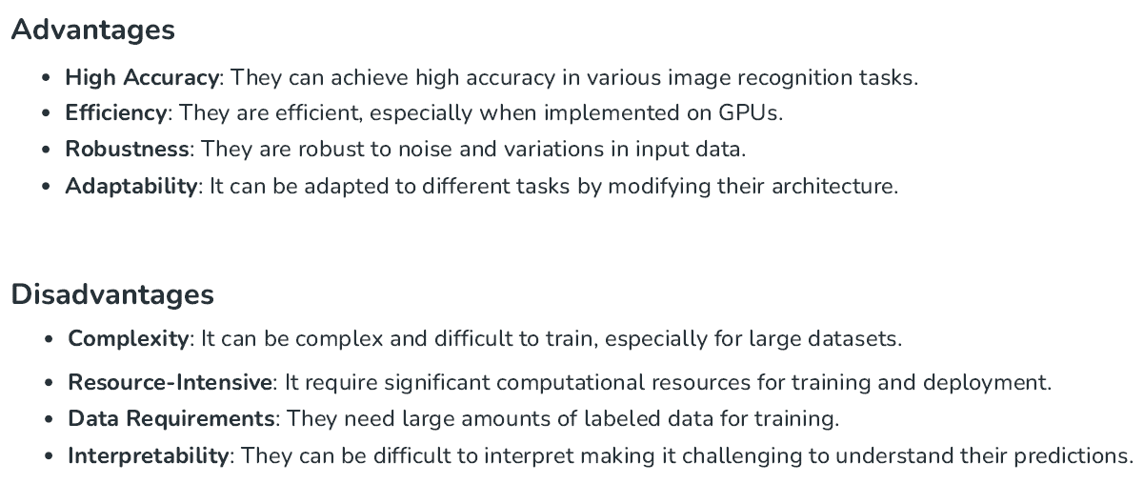
School of Computing and Information Technology, Eastern International University (EIU) - Vietnam

Slide 24
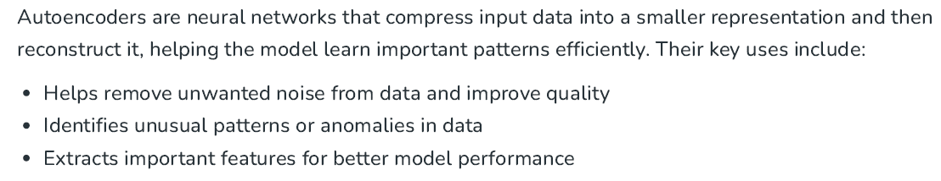
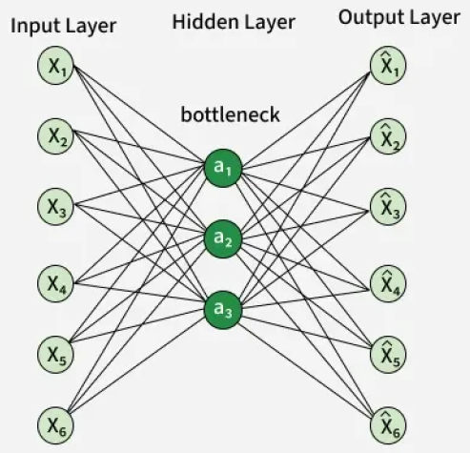

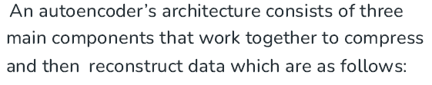
School of Computing and Information Technology, Eastern International University (EIU) - Vietnam

Slide 25
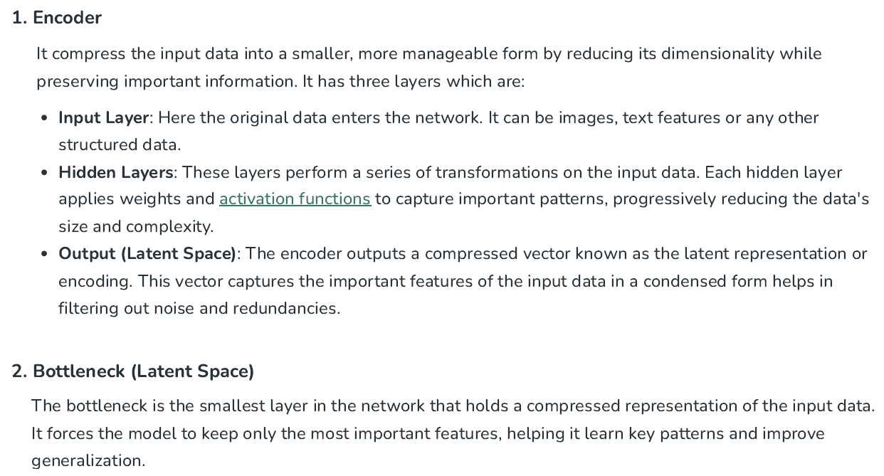

Slide 26
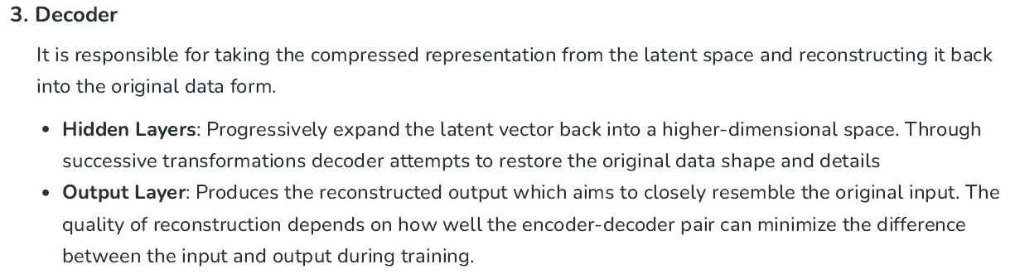
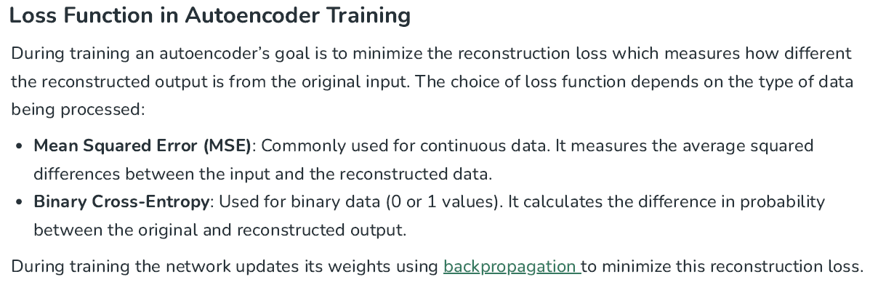

Slide 27
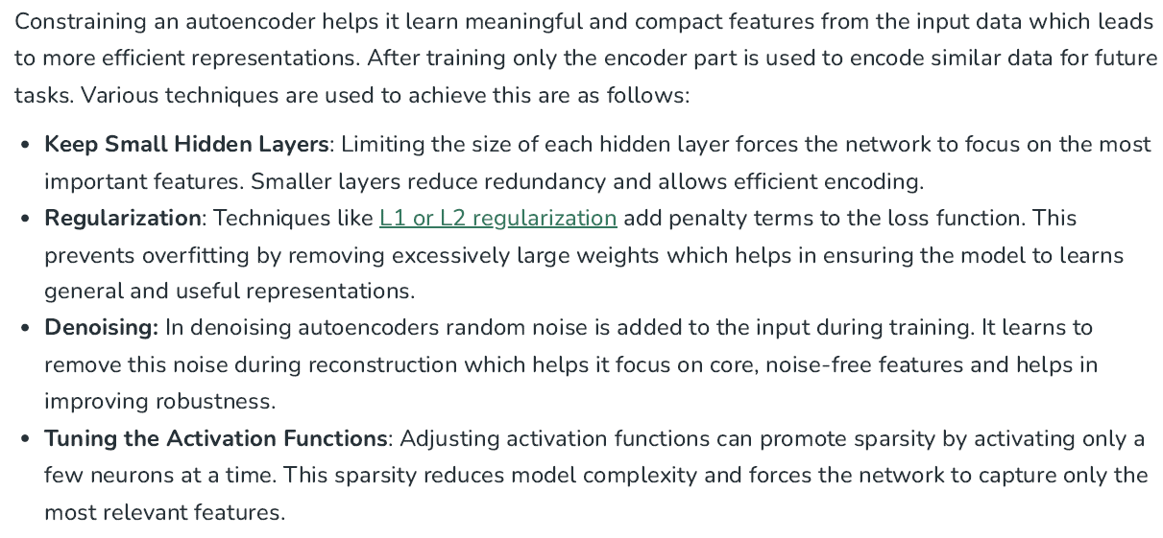

Slide 28

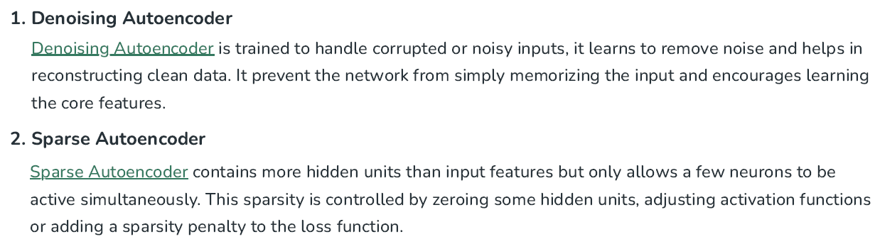
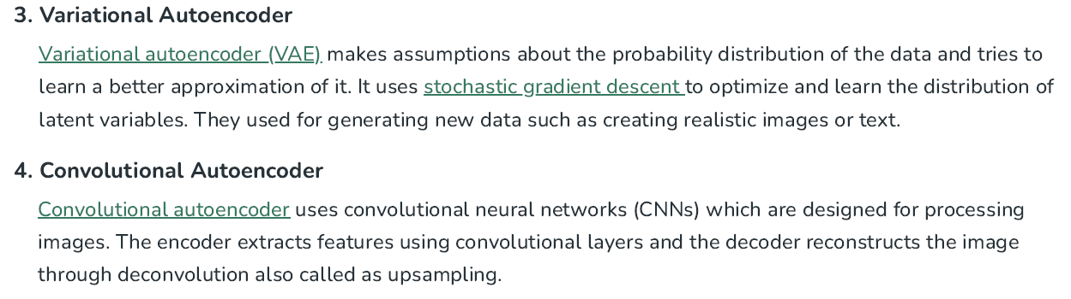

Slide 29

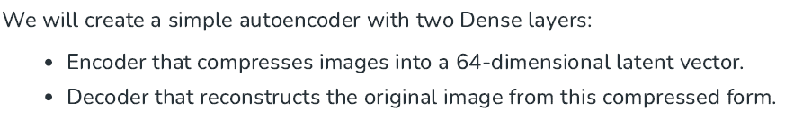

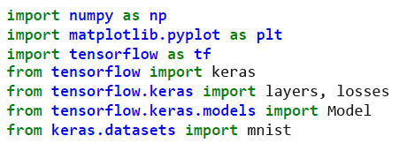
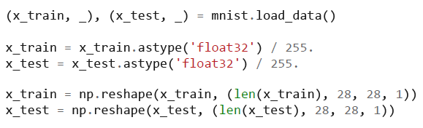



Slide 30
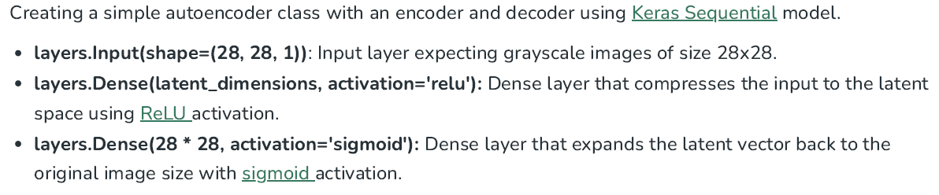
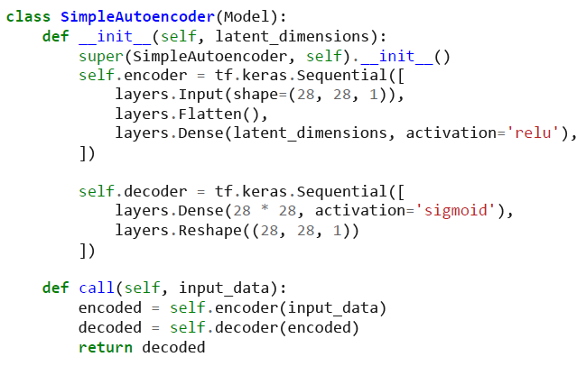

Slide 31
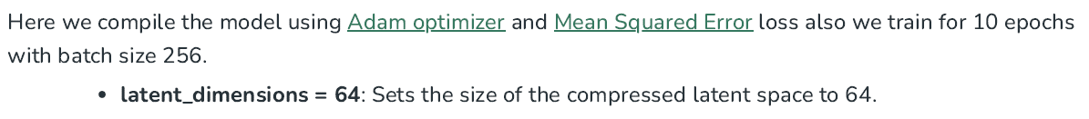
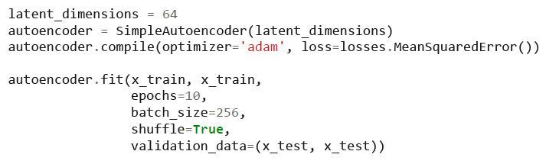
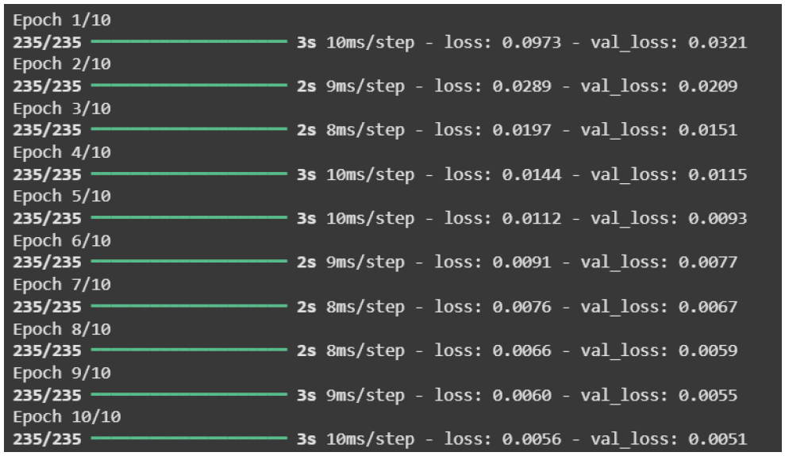
School of Computing and Information Technology, Eastern International University (EIU) - Vietnam

Slide 32
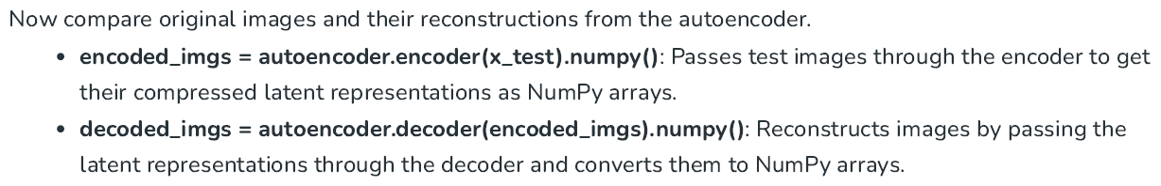
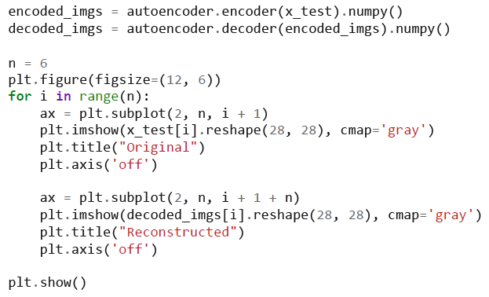


Slide 33


School of Computing and Information Technology, Eastern International University (EIU) - Vietnam

Slide 34




School of Computing and Information Technology, Eastern International University (EIU) - Vietnam

Slide 35


School of Computing and Information Technology, Eastern International University (EIU) - Vietnam

Slide 36



Slide 37


School of Computing and Information Technology, Eastern International University (EIU) - Vietnam

Slide 38





Slide 39



Slide 40




Slide 41



Slide 42


School of Computing and Information Technology, Eastern International University (EIU) - Vietnam

Slide 43

School of Computing and Information Technology, Eastern International University (EIU) - Vietnam

Slide 44






Slide 45






School of Computing and Information Technology, Eastern International University (EIU) - Vietnam

Slide 46



School of Computing and Information Technology, Eastern International University (EIU) - Vietnam

Slide 47





